Slide 1






Temporal Dynamics and Predictive Modeling of Uber-Ride Demand in Urban Environments Data 606|Team 5
Instructor : Masoud Soroush

Slide 2
Problem Statement
Determinants of Uber fares
Impact of Weekday and Weekend
Enhancing Deep Learning for Passenger fare

Slide 3
DATA
NYC Taxi Limousine Commission(TLC)
Yellow Taxi
For-Hire Vehicles
High Volume For-Hire Vehicles

Slide 4

Project-Flow
Data Loading
Data Analysis
Data Processing
Data Modeling

Slide 5
Dataset
Combined 3 Months Data
Size – 1.5 gb
Combinely 18 lakhs Rows and 24 Columns
2 datetime coumns with missing values

Slide 6
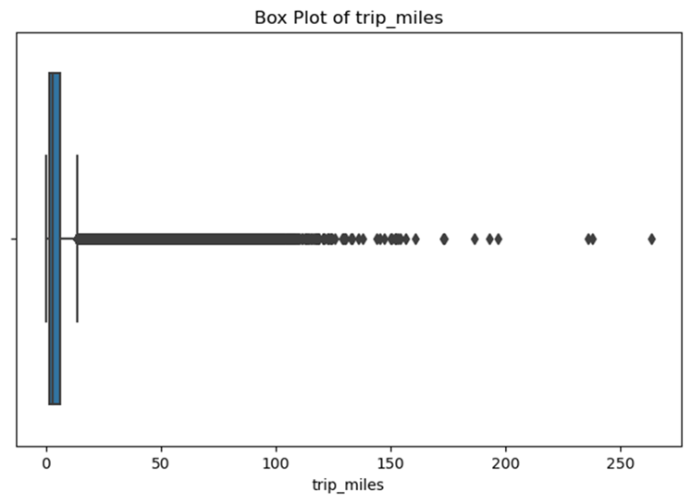
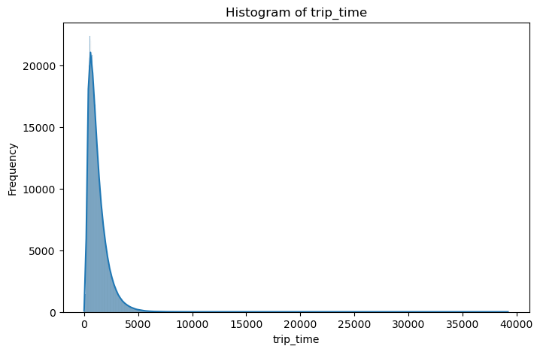
EDA

Slide 7
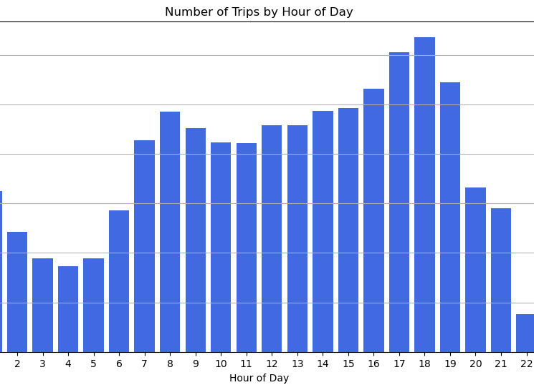
Rides per Hour
In Hours 16 – 19 , there are more number of trips than all the hours for the period of 3 months

Slide 8
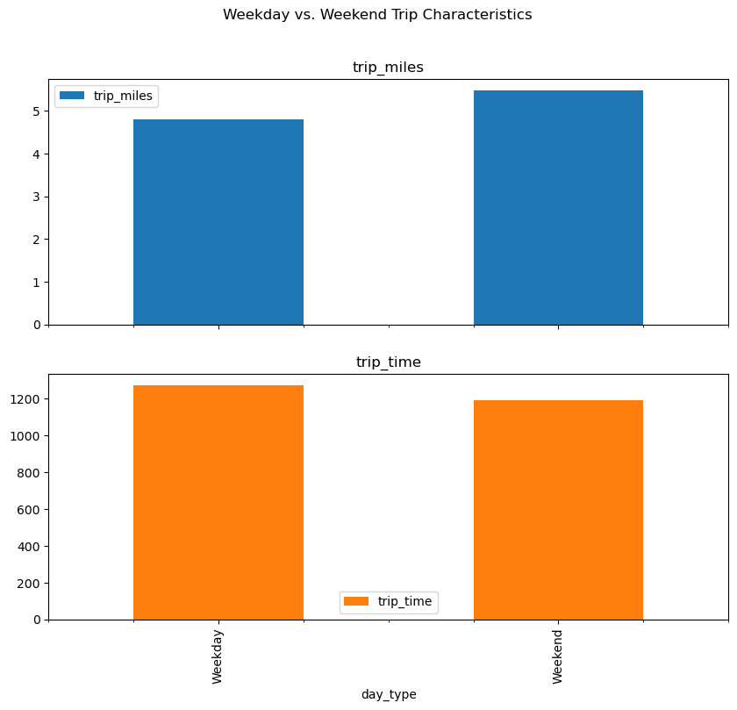
Comparison of Rides
Trip miles is more on weekend than Weekday
In weekend uber takes more time on Weekdays compared to Weekend

Slide 9
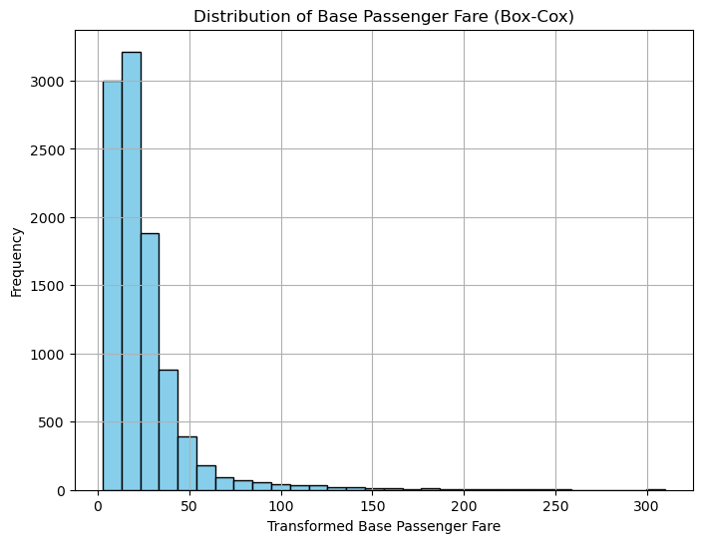
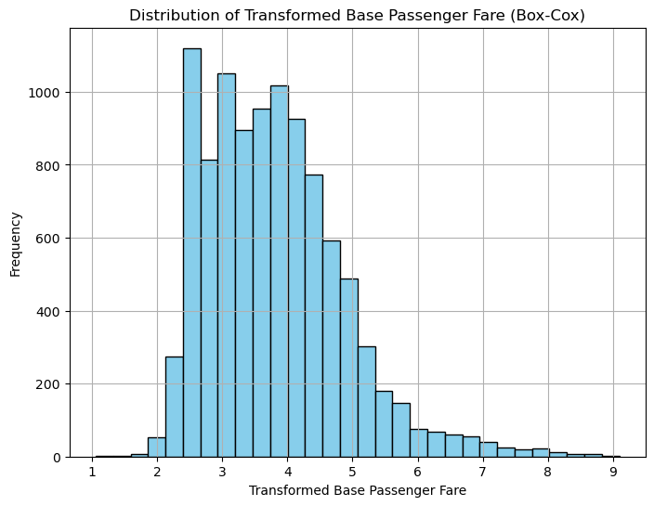
Box-Cox Transformation

Slide 10
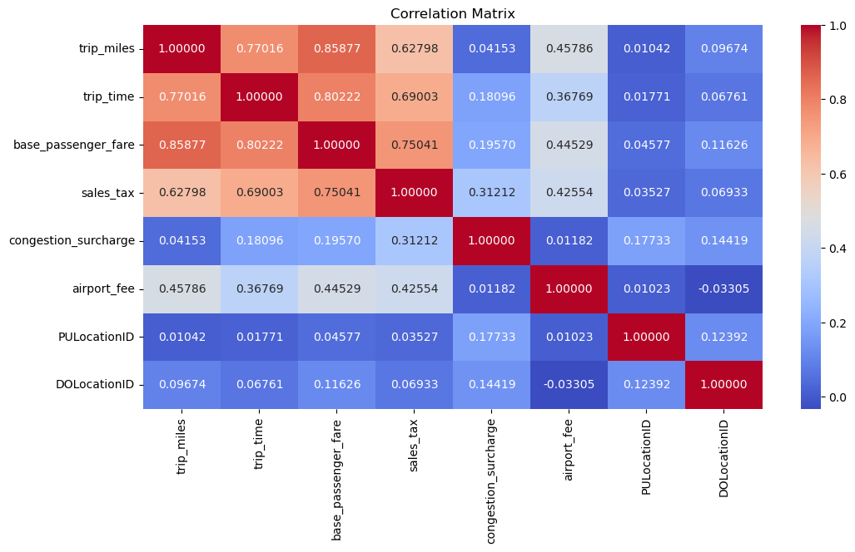
Correlation Matrix

Slide 11
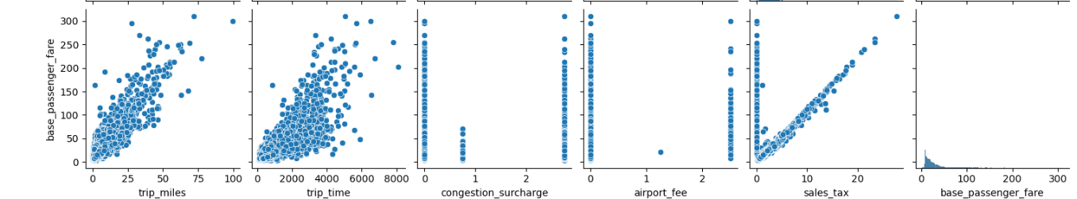
Pair plot

Slide 12
Feature Engineering
Pickup_hour : Extraction of pickup hour from timestamp
pickup_day : Converting of date to day of week as Monday =0, Sunday = 6.

Slide 13
Features
Trip_miles
Trip_time
Sales_tax
PULocationID
DOLocationID
Pickup_hour
Pickup_day
Target Variable – base_passenger_fare

Slide 14
ML Models
Supervised Learning Technique
Linear Regression
Decision Tree
XG Boost

Slide 15
Linear Regression
.
Split the model to 80% of Training and 20% of Test set, random_state = 42
Metrics | Train Values | Test Values
R - Squared | 78.93% | 79.27%
RMSE | 9.879 | 9.828
MAE | 5.650 | 5.640

Slide 16
Decision Tree
Metrics | Train Values | Test Values
R - Squared | 64.72% | 65.54%
RMSE | 12.835 | 12.674
MAE | 6.921 | 6.898

Slide 17
XG Boost
Metrics | Train Values | Test Values
R - Squared | 81.91% | 82.2%
RMSE | 9.181 | 9.012
MAE | 4.904 | 4.832

Slide 18
Hyperparameter Tuning with XG Boost
Randomized Search CV
objective ='reg:squarederror', colsample_bytree = 0.7, learning_rate = 0.1,
max_depth = 5, gamma = 0.2, n_estimators = 300
 | Train Values | Test Values
R - Squared | 83.58% | 83.44%
RMSE | 8.721 | 8.786
MAE | 4.595 | 4.606

Slide 19
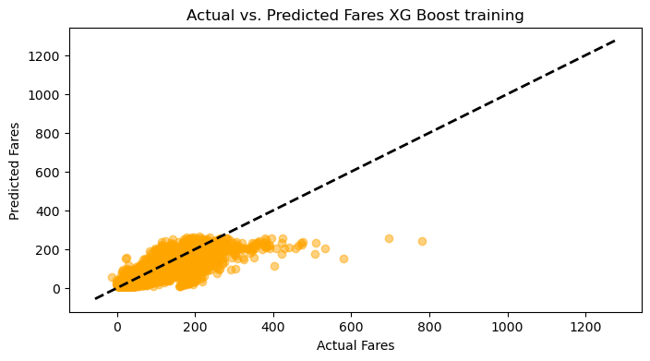
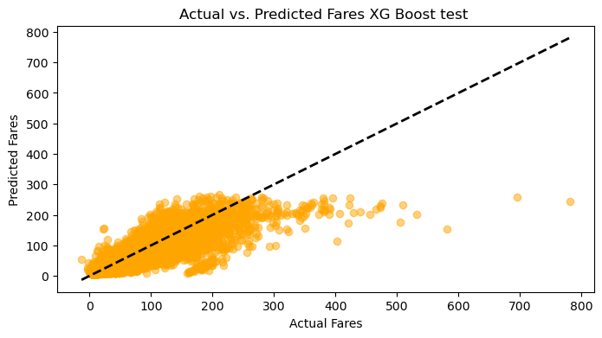
Visual Representation of XG Boost

Slide 20

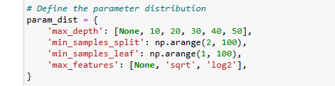
Decision Tree Hypertuning Parameter
Randomsearch CV from sklearn.model
max_depth=40, min_samples_split=48,
min_samples_leaf=57, max_features=None, random_state=42
R_2 = 82.51%
RMSE = 9.029
MAE = 4.944

Slide 21
Deep Learning Technique
Fully Connected Neural Network
Used Sequential model in keras tensorflow, we have 3 layers with dense of 64, 32 and 1.
Model with ‘relu’ activation and ‘adam’ optimization
Performed for 10 , 15 and 25 epochs

Slide 22
Comparison of Metrics with Epochs
EPOCHS | 10 | 15 | 25
R- Squared | 77.57% | 78.09% | 78.38%
RMSE | 10.195 | 10.102 | 10.006
MAE | 5.344 | 5.400 | 5.272

Slide 23
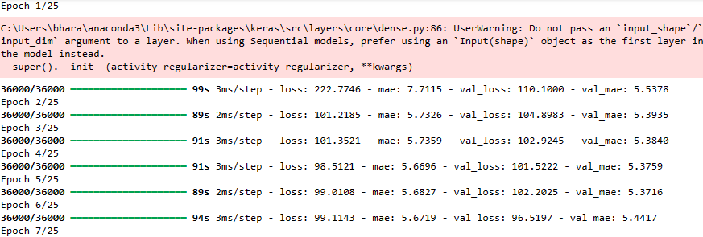
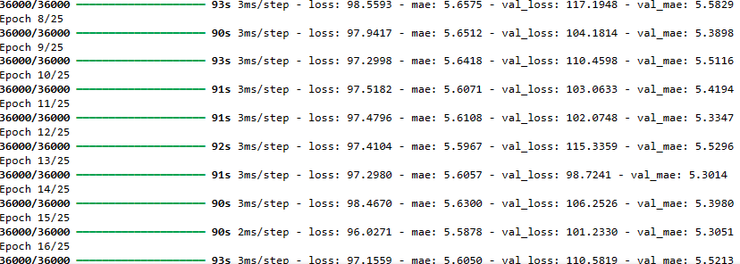

Slide 24
Best Model Order
XG Boost
Decision – Tree
Fully – Connected Neural Network
Linear Regression

Slide 25
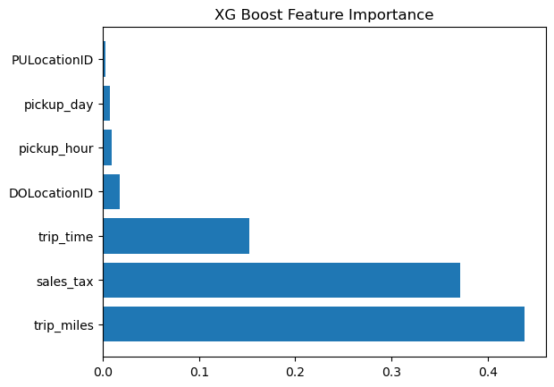
Feature Importance of XG Boost

Slide 26
Conclusion
Parameters trip_miles, sales_tax and trip_time are most dependable
Not much difference in fare while comparing weekday and Weekend.
XG Boost gives most accuracy among the models

Slide 27
Challenges Faced
Data is huge
System is down while running 50 epochs

